Slide 1
Operating Systems
Week#2-Evolution of operating systems and types

Slide 2
Evolution of Operating Systems
Hardware upgrades plus new types of hardware
New services
Fixes

Slide 3
Batch Operating Systems
A Batch Operating System is a type of operating system where similar jobs are grouped together and executed sequentially without user interaction. These systems were commonly used in early computers for processing large amounts of repetitive tasks efficiently.
Key Features:
Job Scheduling: Jobs are collected, grouped, and processed in batches.
Automatic Execution: No user intervention is needed once a batch is submitted.
Sequential Processing: Jobs are executed in the order they are received.
Resource Optimization: Maximizes CPU utilization by reducing idle time.
No Direct User Interaction: Users submit jobs offline, and results are received later.

Slide 4

Issues with Simple Batch Systems
I/O devices too slow compared to the processor
Processor must wait for I/O instruction to complete before proceeding
Processor is often idle

Slide 5
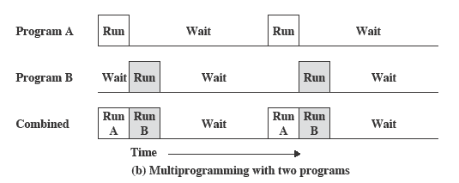
Multiprogrammed Batch Systems
When one job needs to wait for I/O, the processor can switch to the other job

Slide 6
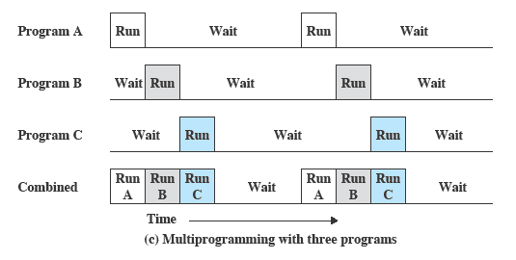
Contd.

Slide 7
Contd.
Saves time w.r.t simple batch processing
Processor can switch jobs while waiting for I/O device
Requires a DMA
I/O interrupts to send interrupts to processor
Jobs are kept in memory
Some sort of memory management is required

Slide 8
Time Sharing Systems
Developed in 1960s
Ability for different users to interact with a mainframe computer
Accommodating Multiple users at the same time
Processors time was shared among various users
A system clock generated interrupts
At a rate of approx. 0.2 secs
This technique is known as Time Slicing
Thus at regular intervals, the current user would be pre-empted and another user loaded in.

Slide 9
Contd.
To preserve the old user program status for later resumption, the old user programs and data are written out to a disk before the new user programs and data were read in
Subsequently, the old user program and data were restored back in the main memory, when the program was next given a turn.

Slide 10
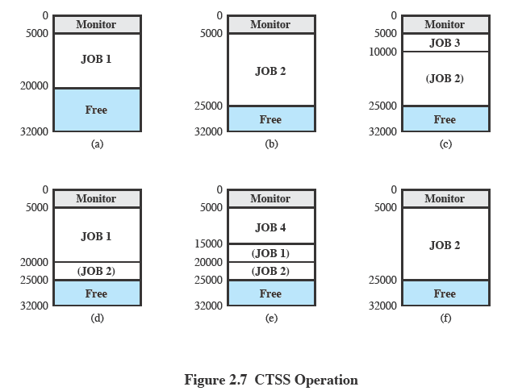
Time Sharing System
Notes:
The console commands implemented at the time were login, logout, input, edit, fap, mad, madtrn, load, use, start, skippm, listf, printf, xdump and xundump

Slide 11
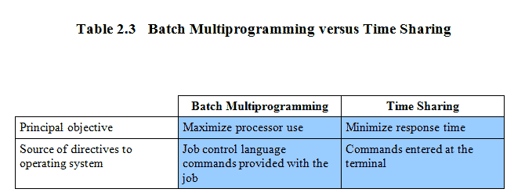
Time Sharing vs Multiprogramming Batch Systems

Slide 12
Personal Computer Systems
A computer system is dedicated to a single user is called personal computer, appeared in the 1970s. Micro computers are considerably smaller and less expensive than mainframe computers. The goals of the operating system have changed with time; instead of maximizing CPU and peripheral utilization, the systems developed for maximizing user convenience and responsiveness. For e.g., MS-DOS, Microsoft Windows and Apple Macintosh.

Slide 13
Parallel Systems
As the demand for performance increased, multiprocessor systems were developed
Multiprocessor systems have more than one processor which share the same memory and I/O devices
The advantages of parallel system are as follows:
Enhanced performance
Execution of several tasks by different processors concurrently, increases the system's throughput without speeding up the execution of a single task.
If possible, system divides task into many subtasks and then these subtasks can be executed in parallel in different processors. Thereby speeding up the execution of single tasks.
Reliability; if one processor fails another can be used in its place
OS must exploit these hardware features
Presence of multiple processors should not be apparent to the users
Must manage scheduling within each processor and synchronization among various processors

Slide 14
Distributed Systems
Distributed systems distribute computation among several processors. In contrast to tightly coupled systems (i.e., parallel systems), the processors do not share memory or a clock. Instead, each processor has its own local memory.
The processors communicate with one another through various communication lines (such as high-speed buses or telephone lines). These are referred as loosely coupled systems or distributed systems. Processors in a distributed system may vary in size and function. These processors are referred as sites, nodes, computers and so on.

Slide 15
Contd.
The advantages of distributed systems are as follows:
As there are multiple systems involved, user at one site can utilize the resources of systems at other sites for resource-intensive tasks.
Fast processing.
Less load on the Host Machine.

Slide 16
Network Operating System (NOS)
A Network Operating System (NOS) is an operating system designed to manage, control, and facilitate communication between multiple computers in a network. It allows users to share files, applications, and resources such as printers and internet connections efficiently.
Advantages:
Efficient resource sharing (printers, files, applications).
Improved security with centralized user management and access control.
Scalability – Can accommodate an increasing number of users and devices.
Remote administration for network monitoring and troubleshooting.

Slide 17
Disadvantages:
Requires dedicated hardware (servers) for efficient performance.
Complex setup and maintenance, needing skilled administrators.
High cost for implementation and licensing in enterprise environments.

Slide 18
Mobile Operating Systems
A mobile operating system (mobile OS) is an OS built exclusively for a mobile device, such as a smartphone, personal digital assistant (PDA), tablet or other embedded mobile OS. Popular mobile operating systems are Android, Symbian, iOS, BlackBerry OS and Windows Mobile.
A mobile has very limited resources and has a lot of constraints such as battery, memory, processor power, etc. A mobile OS is similar to a standard OS (like Windows, Linux, and Mac) but is relatively simple and light and primarily manages the wireless variations of local and broadband connections, mobile multimedia and various input methods.
Notes:
Mobile operating systems also manage cellular and wireless network connectivity, as well as phone access.

Slide 19
THANK YOU!

